Slide 1

Fraud detection in Transaction clean analyze and identify suspicious transaction
PRESENTED BY :
906 PALSAMKAR NIMESH
907 PIYARJI AAMINA
908 RAI RIYA
909 RANGDAL VEDANT
910 SHAIKH RAYHAN

Slide 2
BUSINESS PROBLEM
Problem Statement :
Financial institutions face huge losses due to fraudulent transactions.
Manual detection is inefficient because fraud cases are rare and hidden among millions of transactions.
Why This Matters :
Fraud causes financial loss and customer distrust.
Traditional rule-based systems fail to detect new fraud patterns.
Need for automated & intelligent detection system.

Slide 3
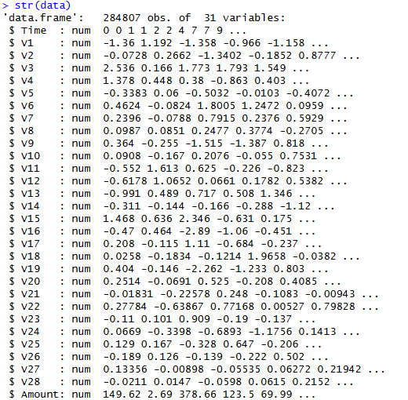
Data Architecture
Data is get from Kaggle in form of CSV.
Dataset collected from transaction records.
Contains numeric transaction features.
Checked for missing values
Converted required columns to numeric format.
Prepared data for analysis
colSums(is.na(data)) : This command use to checks and counts missing (NA) values in each column of the dataset.

Slide 4
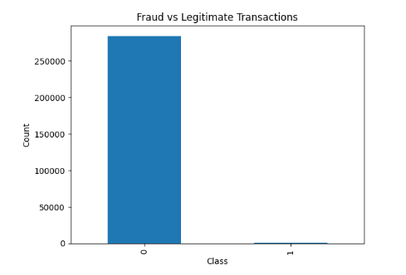
Exploratory Insights :
Graph: Fraud vs Legitimate Transactions.
Very high number of legitimate transactions.
Very few fraudulent transactions.
Strong class imbalance problem.

Slide 5
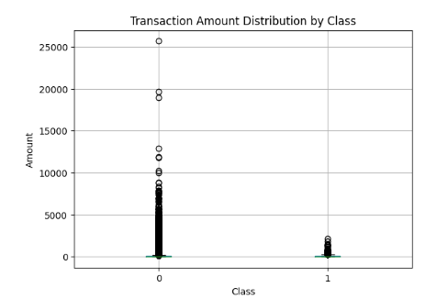
Exploratory Insights :
Graph: Boxplot of Transaction Amount by Class.
Fraud transactions usually have lower transaction amounts.
Legitimate transactions have a wider spread.
Several outliers exist in normal transactions.

Slide 6
Feature Strategy :
Standardized numerical features (Time, Amount).
Converted target variable into factor.
Applied ROSE to balance minority class.
Removed unnecessary or redundant attributes.
train_balanced <- ROSE(Class ~ ., data = train, seed = 1)$data.

Slide 7

Modeling Approach :
Why Random Forest?
Handles Non-Linearity:
Reduces Overfitting:
Robust to Noisy Data:
Effective on Imbalanced Data:
Higher Predictive Accuracy:

Slide 8
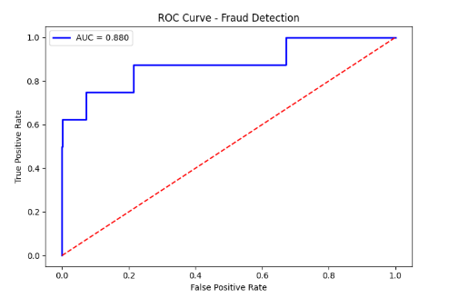

Model Evaluation :
The ROC curve shows the trade-off between True Positive Rate and False Positive Rate.
The curve is clearly above the diagonal line, which means the model performs better than random guessing.
The AUC value (~0.9) indicates strong fraud detection capability.
This proves the model can effectively distinguish fraudulent vs legitimate transactions.

Slide 9
Actionable Business Recommendations:
Proactively monitor high-risk transactions:
Reduce false approvals through real-time alerts:
Focus on low-amount, high-frequency transactions:
Use fraud probability for prioritization, not all transactions equally:

Slide 10
TECHNICAL REFLECTION
tidyverse: Used for data manipulation, cleaning, and handling large datasets efficiently.
ggplot2: Used to create high-quality visualizations for exploratory data analysis.
caret: Used for data splitting, model training, and performance evaluation.
ROSE: Used to handle class imbalance by generating synthetic fraud samples.
randomForest: Used to build the fraud detection model using an ensemble of decision trees.
pROC: Used to evaluate model performance using ROC curves and AUC scores.

Slide 11
THANK YOU

